Slide 1
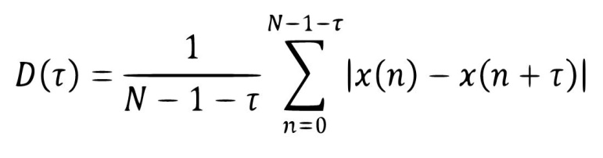

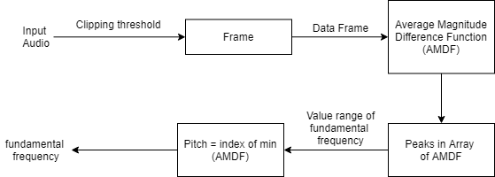
Average Magnitude Difference Function
Period detection technology for weak characteristic signals is very important in the fields of speech signal processing, mechanical engineering, etc.
Average magnitude difference function (AMDF) is a widely used method to extract the period of periodic signal for its low computational complexity and high accuracy.
The original AMDF is defined as:
Block diagram

Slide 2
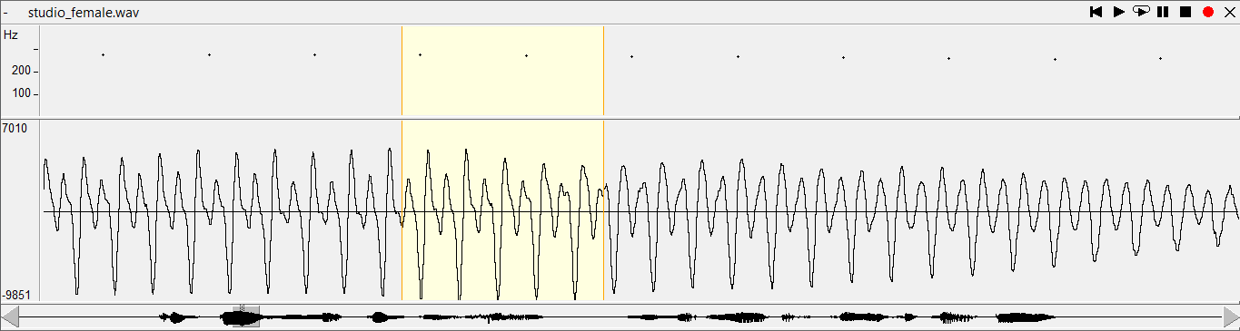
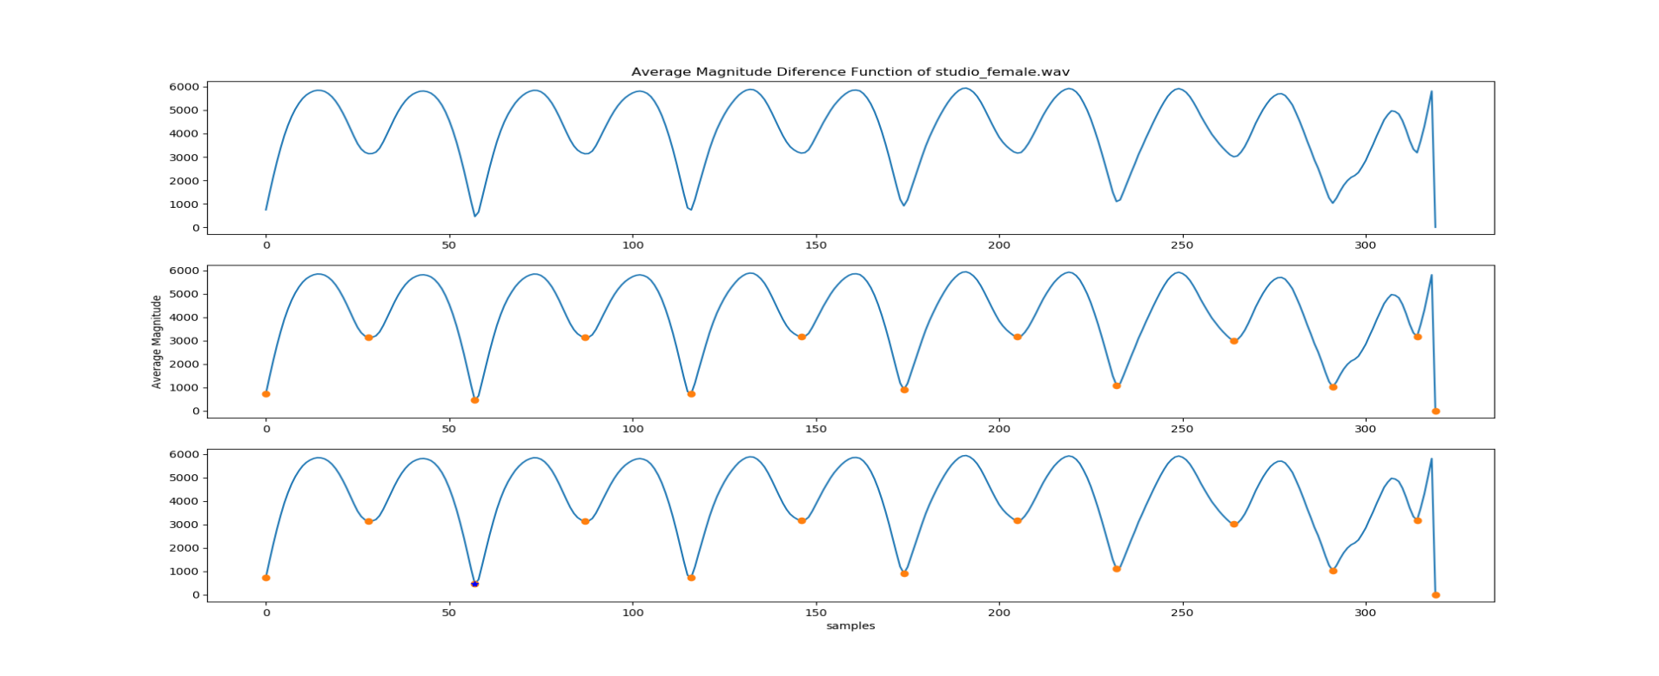
Frame using AMDF
Pick a frame in original signal with time samples from 0.902s to 0.922s

Slide 3
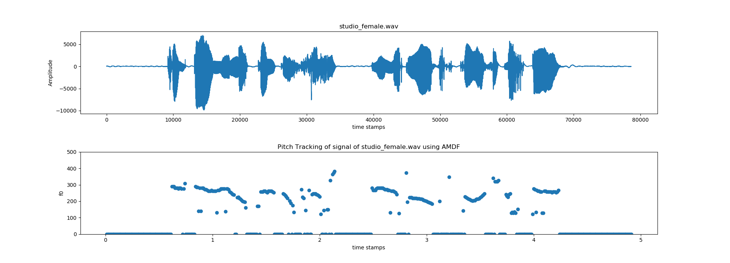
Result
Conclution:
The results are relatively accurate in a studio environment.
There are some inaccuracies due to noise, and it is difficult to determine cyclic time and non-cyclic time.
It is necessary to filter by the following methods: median filter, Top-Hat.

